Slide 1

Introduction To Python
5th Computer Science

Slide 2
Learning Intentions
Understand the difference between syntax & logical error
Demonstrate the use of escape characters
Demonstrate the use of both single line comment & multiline comments

Slide 3

High Level vs Low Level languages
Python is a high level language.
A high level language is a programming language whose source code is easy for humans to read as it is similar to our natural language. Computers need to translate it before they can read and run it.
print(“Hello World”)
A low level programming language are difficult for humans to read and write but easier for a computer to run. They consist of machine code and Assembly language

Slide 4
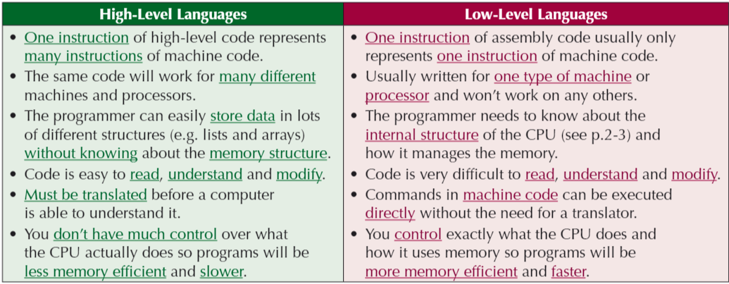
High Level vs Low Level languages

Slide 5
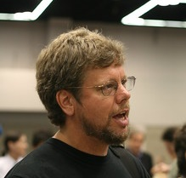
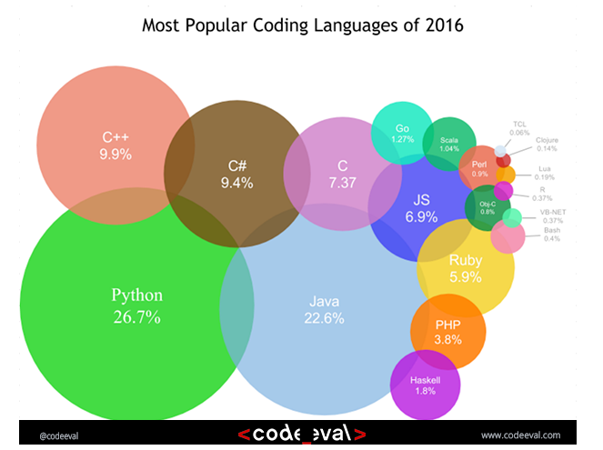
History of Python
Started by Guido Van Rossum as a hobby
Now widely spread
Open Source! Free!
Versatile
Guido Van Rossum by Doc Searls on Flickr CC-BY-SA
Notes:
Started by Guido Van Rossum as a hobby over the Christmas vacation.
- named after Monty Python's Flying Circus
- First released in 1991, loved by Unix scripters
- Now transformed into the most popular interpreted language. You can build anything with it!
- Facts! Python was the most used language in 2016 and still most likely is!

Slide 6
Python today
Developed a large and active scientific computing and data analysis community
Now one of the most important languages for
  Data science
  Machine learning
  General software development
Packages: NumPy, pandas, matplotlib, SciPy, scikit-learn, statsmodels
Notes:
Why choose it instead of MATLAB, R, SAS, Stata and others?
- It is free and open source
- Intuitive and easy to learn
- Extremely versatile – examples – websites, planes, robots, data
- Large and friendly community
- packages
Very important in industry and academia

Slide 7
Python’s syntax is simple. It’s much like writing in English, and this is why it is easy to read (and understand) and write code in Python.
Python code is concise. Unlike Java, you can get things done in less lines of code.
Python is open-source and its source code is available to the public for free
Portable: Code you write on Windows can be transferred to Mac as it is and the other way around
Come with an excellent library of tools to help you write programs quickly and easily.

Slide 8
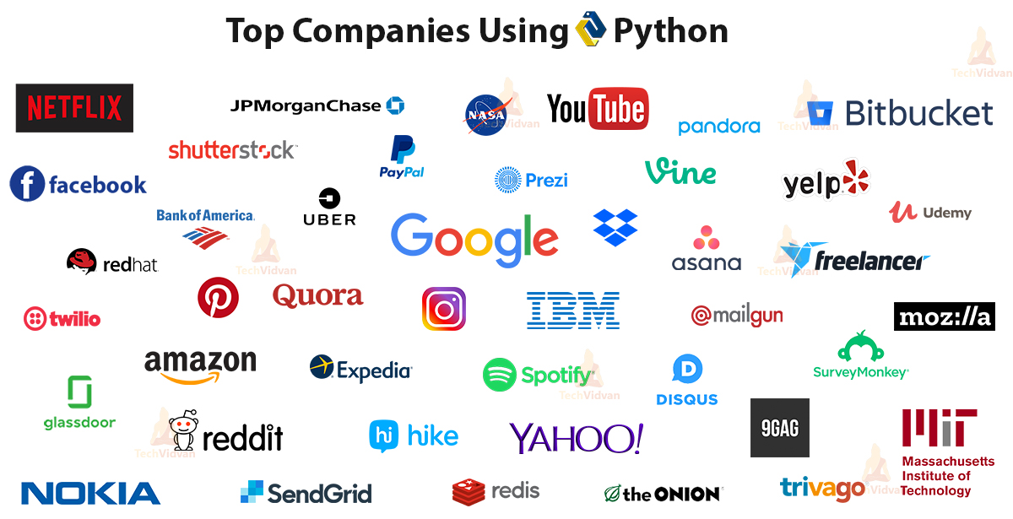

Slide 9
Recap from last Class
In your documents, create a folder called computer Science. In the computer Computer Science folder create a folder called python
Open Thonny Python
Create a new file
Save the file as String.py in the folder OneDrive\Computer Science\Python

Slide 10
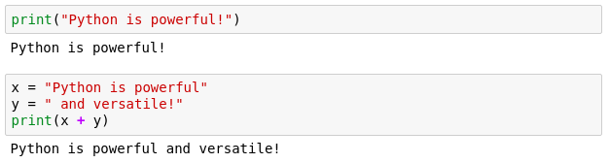
Printing
When writing scripts, your outcomes aren't printed on the terminal.
Thus, you must print them yourself with the print() function.
Beware to not mix up the different type of variables!

Slide 11
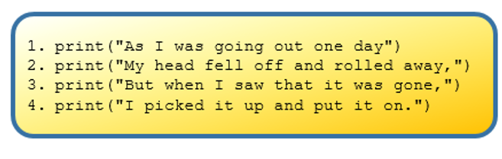
Control of Flow

Slide 12
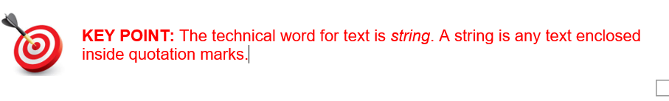
Strings
Strings are enclosed by 2 quotation marks “ ”
print(“hello world”)
print(“7”)
print(7)

Slide 13

Quick quiz
What will be the result?

Slide 14

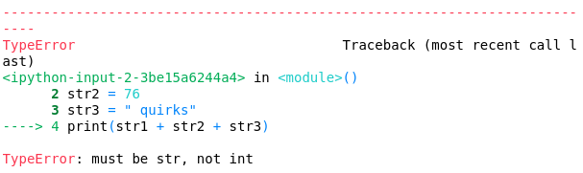
Do you see anything wrong with this block?
Notes:
Let's see if everybody remembers their types
Is there anything wrong with this block or will it execute nicely?
[issue] Any idea how we can fix it?

Slide 15
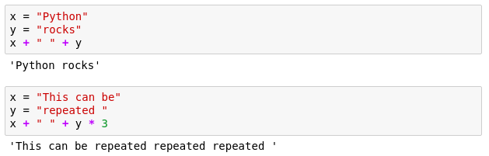
Strings

Slide 16
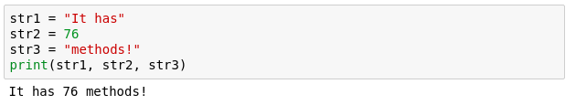
Another more generic way to fix it
If we comma separate statements in a print function we can have different variables printing!

Slide 17
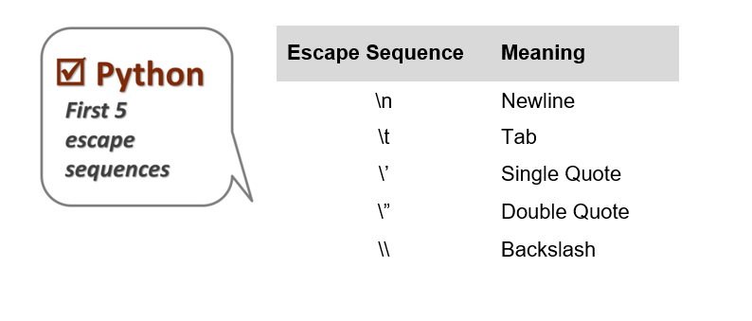
Escape Characters

Slide 18
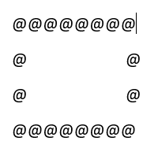
Create a program that prints this out.

Slide 19
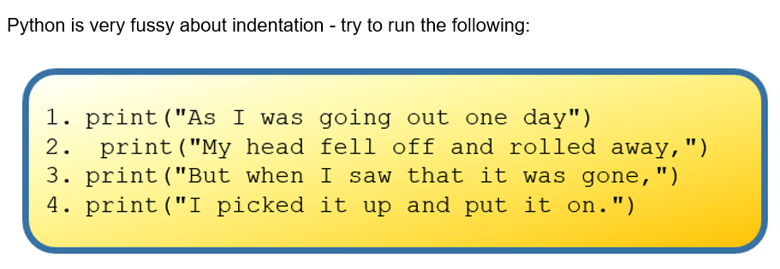
Indentation

Slide 20
Commenting
Useful when your code needs further explanation. Either for your future self and anybody else.
Useful when you want to remove the code from execution but not permanently
Comments in Python are done with #
Notes:
You seen the # symbols in the slides.
I forget what I write; need to remind my future self
Programmers though it's better to write explanation in between the code
Show example

Slide 21
Commenting
Useful when your code needs further explanation. Either for your future self and anybody else.
Useful when you want to remove the code from execution but not permanently
Comments in Python are done with #
Notes:
You seen the # symbols in the slides.
I forget what I write; need to remind my future self
Programmers though it's better to write explanation in between the code
Show example

Slide 22
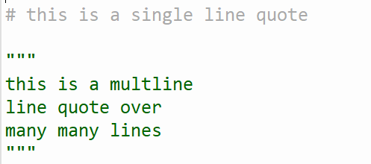
Commenting

